Slide 1

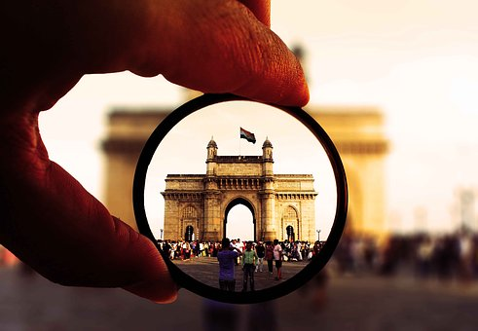
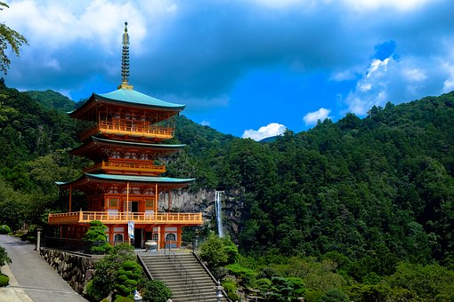

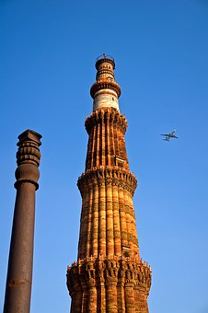
TCSへようこそ！ Welcome to TCS
Oct-2025
Notes:
1
1

Slide 2
Misumi Inc., Japan
Mr. Kaoru Morino - Corporate Officer, NEWTON Deplyment Head Office
Mr. Yoruske Amemiya - General Manager, NEWTON Deplyment Head Office
Mr. Masanao Ishihara - Chief Director, NEWTON Deplyment Head Office
Mr. Youngho Kim - Chief Director, NEWTON Deplyment Head Office
TCS Japan
Mr. Takashi Sato – IT IS Unit Head
Mr. Yukinori Harada – SBP- SAS Co Head
Mr. Hajime Hirose – Project Manager
TCS India
Mr. Laxmikant Shaligram – Deputy Service Delivery Head, JDC
Mr. Sagar Borgaonkar - Head of Strategic Initiatives, JDC
Mr. Sayyad Abbashaider Head of Sales & Solutions, IT IS
Mr. B Vijayakumar – Delivery Head, IT IS, JDC
Mr. Sathish Kumar Jothilingam – Delivery Partner, IT IS, JDC
Mr. Unmesh Ghate – Program Manager, PRISM
Ms. Nivedita Kulkarni – Lead, Presales & Customer Experience
Mr. Avinash Muley – Lead, Presales & Customer Experience
Notes:
2

Slide 3
AGENDA @Pune Day-1
6th Oct 2025 (Monday) – S2 Boardroom
Start | End | Duration | Agenda | Presenter (s)/ Stories | Location
9.00 | 10.00 | 1.00 | Move from Hotel to TCS SP | - | -
10.00 | 10.30 | 0.30 | Reception & Security | Avinash | SP Gate-2
10.30 | 11.00 | 0.30 | Visit Agenda / Member Introduction / Context setting | All | S2 Boardroom
11.00 | 11.40 | 0.40 | MISUMI Expectation in India visit | MISUMI | S2 Boardroom
11.40 | 11.55 | 0.15 | Break | All | S2 Boardroom
11.55 | 13.15 | 1.20 | Major Japanese integrated trading and investment Company Case study | Shishank & Team | S2 Boardroom
13.15 | 14.15 | 1.00 | Lunch | All | A1 Poolside EDR
14.15 | 14.45 | 0.30 | Hikari Academy Floorwalk & Campus Tour | Sagar/ Nivedita | S2, Ground Floor
14.45 | 16.00 | 1.15 | Japanese Multinational Convenience Store Company Floorwalk | Shishank | S3, 1st Floor
16.00 | 16.30 | 0.30 | Travel to SP2, Reception & Security | All | -
16.30 | 18:00 | 1.30 | TCS Research Floorwalk | Divyesh | SP-2, TCS Research
18.00 | 18.15 | 0.15 | Day1 Wrap-up | All | SP-2 TCS Research
18.15 | 19.00 | 0.45 | Move to Restaurant | - | -
19.00 | 21.00 | 2.00 | Dinner | - | Taj Vivanta, MYNT
21.00 | 21.45 | 0.45 | Move to Hotel | - | JW Marriott Pune
studioppt I 11 I 2018
Notes:
3

Slide 4
AGENDA @Pune Day-2
7th Oct 2025 (Tuesday) – S2 Boardroom
Start | End | Duration | Agenda | Presenter (s)/ Stories | Location
8.30 | 9.30 | 1.00 | Move from Hotel to TCS SP | -
9.30 | 9.50 | 0.20 | Reception & Security | Avinash | SP Gate-2
9.50 | 10.00 | 0.10 | Visit Agenda (Day-2) | All | S2 Boardroom
10.00 | 11.00 | 1.00 | Major Japanese integrated trading and investment Company Floorwalk | Sunil & Sanjay | S3, 2nd Floor
11.00 | 11.15 | 0.15 | Break | All | S3
11.15 | 12.30 | 1.15 | PRISM Floorwalk & TICO Discussion | Unmesh & Mahesh | S3, 1st Floor
12.30 | 13.00 | 0.30 | Travel to SP2, Reception & Security | All | -
13.00 | 14.00 | 1.00 | Lunch | All | SP-2, Concourse Floor
14.00 | 15.00 | 1.00 | Automation / AI for Business & Operations | Shali / Abhilash/ Sachin | SP-2, 7th Floor, CR1
15.00 | 15.15 | 0.15 | SP2 JDC Floor Walk | All | SP2, 9th Floor
15.15 | 15.30 | 0.15 | Day2 Wrap-up | All | SP-2, 7th Floor, CR1
15.30 | 19.30 | 4.00 | Move to Mumbai (Hotel) | All | - Trident, Nariman Point, Mumbai - Taj President
19.30 | 21.30 | 2.00 | Dinner at Hotel | - | Trident, Nariman Point, Frangipani
studioppt I 11 I 2018
Notes:
4

Slide 5
AGENDA @Mumbai
8th Oct 2025 (Wednesday) – Block-4 Conf. Room
Start | End | Duration | Agenda | Presenter (s)/ Stories | Location
8.00 | 9.00 | 1.00 | Move from Hotel to TCS Banyan Park | -
9.00 | 9.30 | 0.30 | Reception & Security, Move to Conf. Room. | Avinash/ Abbas | Block-1, Security Reception
9.30 | 11.30 | 2.00 | - TCS Overview, Video, JLR racing (0’ 50") - JDC Corner (0’ 30") - JDC Introduction video, JDM details, JDC Stories - EBC Presentation (0’ 15" * 2) – M&S & BestBuy. | Abbas & EBC team | EBC Block
11.30 | 12.00 | 0.30 | Banyan Park Campus Tour | All | Banyan Park
12.00 | 13.00 | 1.00 | Lunch at Banyan Park & Wrap-up | All | Sarosh/ Orchid Villa
13.00 | 13.30 | 0.30 | Move to Mumbai Domestic Airport 13:30 at Airport | - | -
15.35 | 17.35 | 2.00 | Flight from Mumbai to Chennai IndiGo 6E5196 | - | -
18.10 | 18.40 | 0.30 | Move to Hotel (Chennai) | - | Four Points by Sheraton Chennai, Velachery
19.00 | 21.00 | 2.00 | Dinner | - | Taj Coromandel, Southern Spice
studioppt I 11 I 2018
Notes:
5

Slide 6
AGENDA @Chennai
9th Oct 2025 (Thursday) – EB3, 5th Floor, SW Boardroom
Start | End | Duration | Agenda | Presenter (s)/ Stories | Location
8.00 | 9.20 | 1.20 | Move from Hotel to TCS Siruseri | -
9.20 | 9.50 | 0.30 | Reception & Security & Welcome Photo | All | Signature Tower Reception
9.50 | 10.00 | 0.10 | Visit Agenda (Day-4) | All | EB3, 5th Floor, SW Boardroom
10.00 | 11.20 | 1.20 | Large Beverage Company Case Study | J Sathish | EB3, 5th Floor, SW Boardroom
11.20 | 11.40 | 0.20 | Break | All | EB3, 5th Floor, SW Boardroom
11.40 | 12.40 | 1.00 | Large Global Insurance Floorwalk | Srigiri Sreekanth | EB2 4F SW
12.40 | 13.40 | 1.00 | Lunch | All | Signature Tower Ground Floor
13.40 | 14.40 | 1.00 | Cognix Agile DC Floorwalk | Cloud COE team | EB3, 5th Floor, SW Boardroom
14.40 | 15.50 | 1.10 | Large Japan Manufacturing Client Floorwalk | J Sathish | EB3
15.50 | 17.00 | 1.10 | Leading Japan Airline Floorwalk | Rajeshwari Raman | EB3 1F NW
17.00 | 17.30 | 0.30 | Discussion + Wrap up + Feedback | All | EB3, 5th Floor, SW Boardroom
17.20 | 19.00 | 1.40 | Move to Restaurant | - | -
19.00 | 21.00 | 2.00 | Dinner | All | Radisson Blu Hotel
21.00 | 21.30 | 0.30 | Move to Chennai Airport 21:00 (AI346) | - | -
studioppt I 11 I 2018
Notes:
6

Slide 7


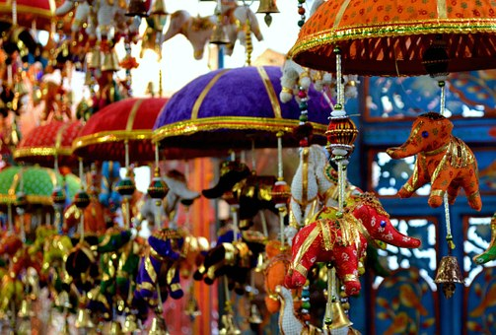
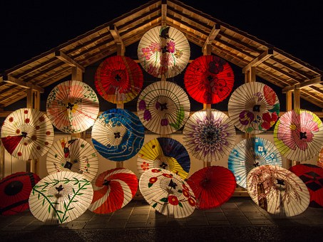


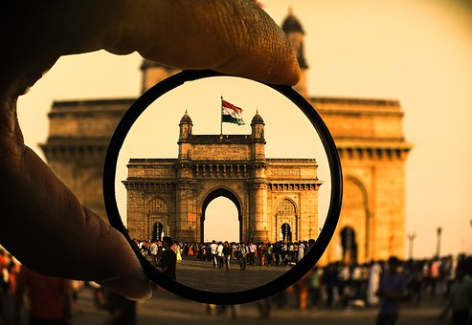
ありがとうございました
studioppt I 11 I 2019

